Slide 1
IoT final presentation
CheckMyWater
Notes:
Maltie

Slide 2
Contents
Story
Demo
PH-Sensor
Communication
Node-Red
Integration with CheckMyWater
Struggles
Reflection
Notes:
Maltie

Slide 3
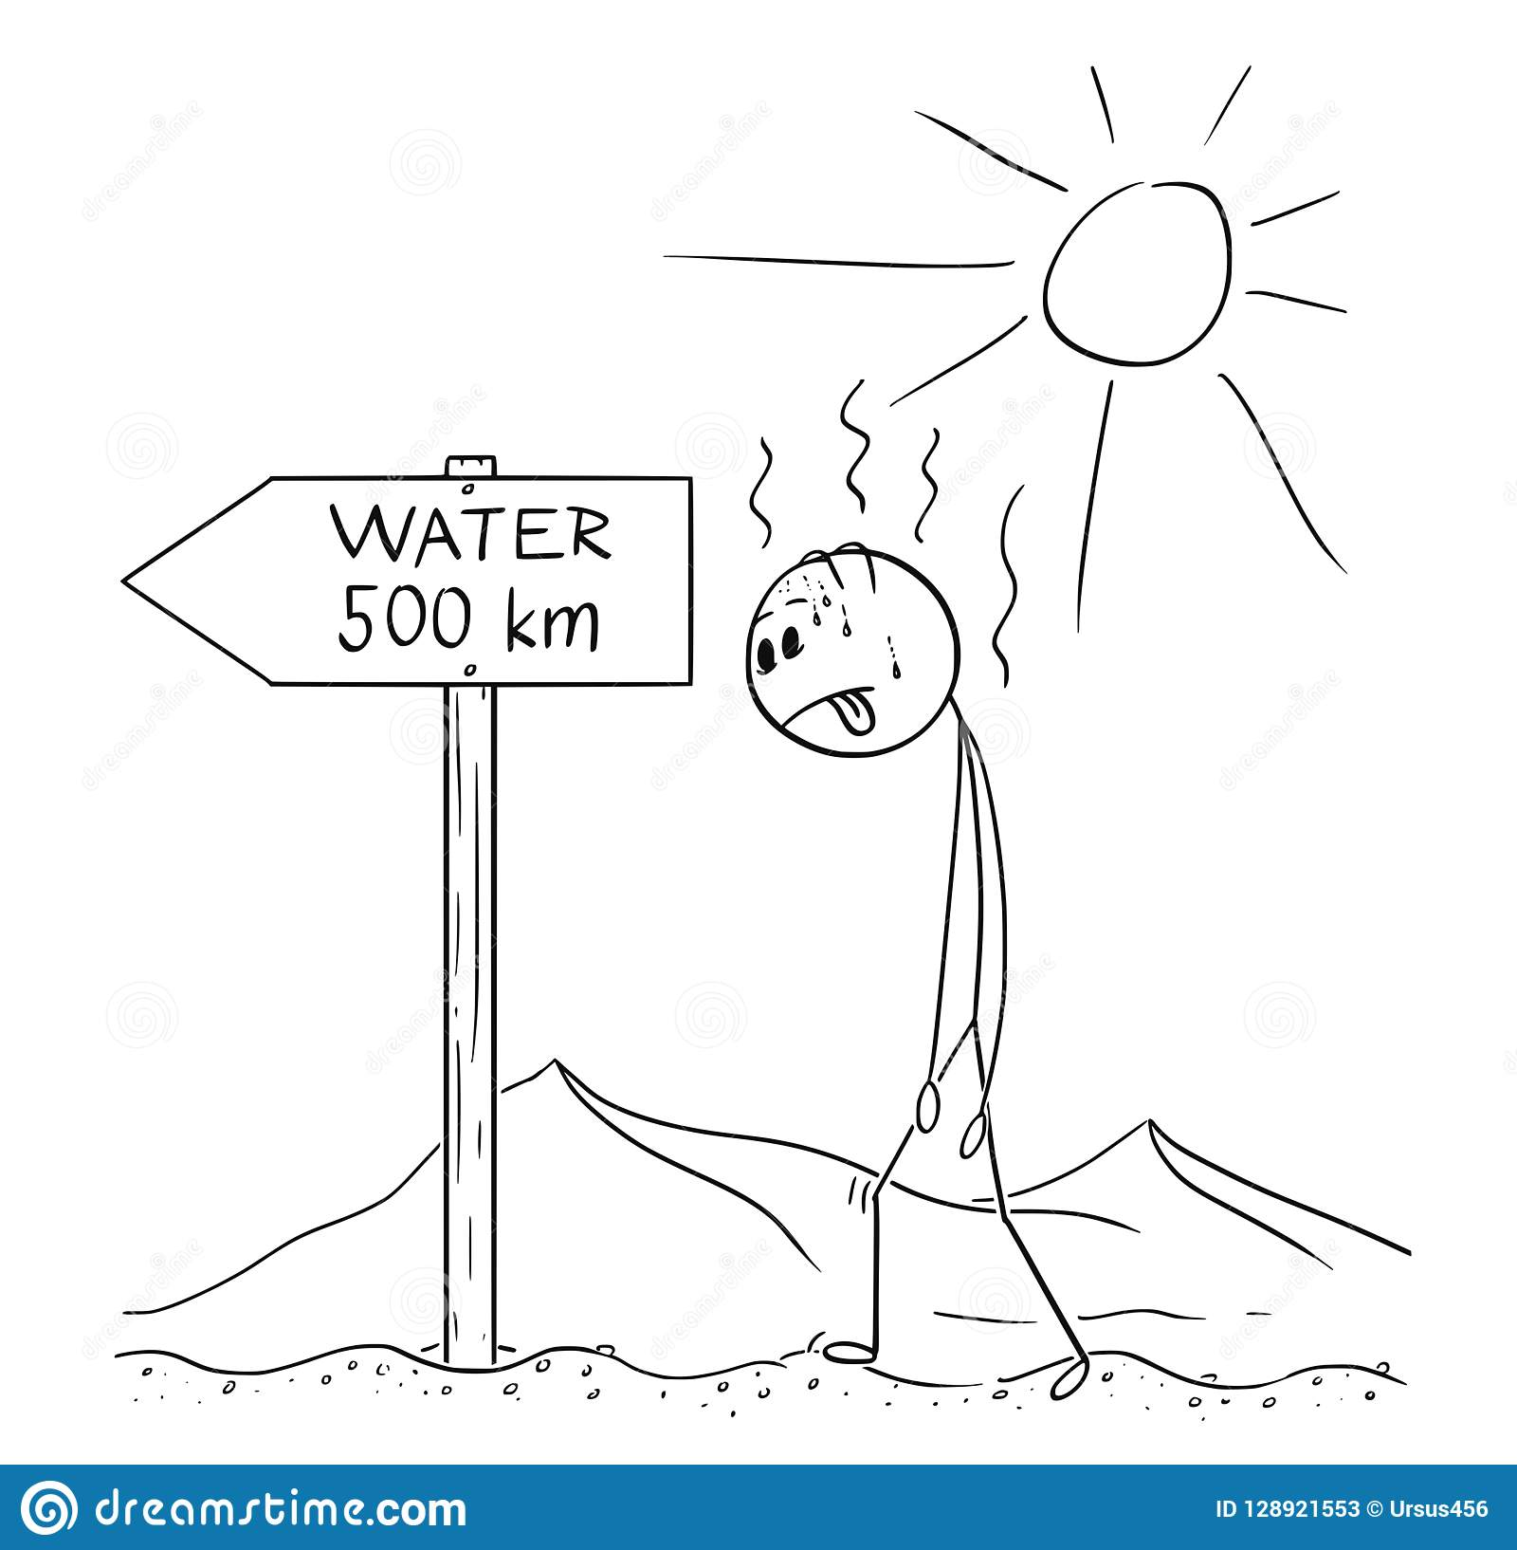
Story
Pablo Holland
South African student in the Netherlands
Pablo goes back home
Very thirsty
Notes:
Maltie

Slide 4
Demo
Notes:
Video

Slide 5
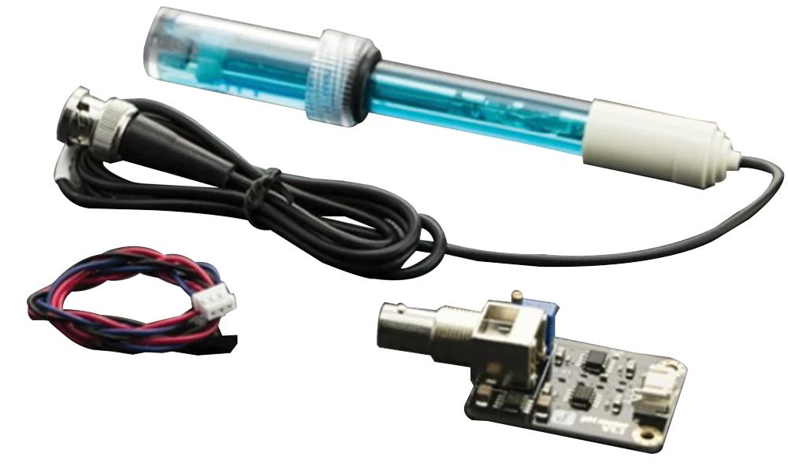
PH sensor
Notes:
Tom

Slide 6
Communication
PH meter (analog)
Serial (9600 bps)
MQTT (test01/strip2/rgb/set)
Notes:
Tom

Slide 7
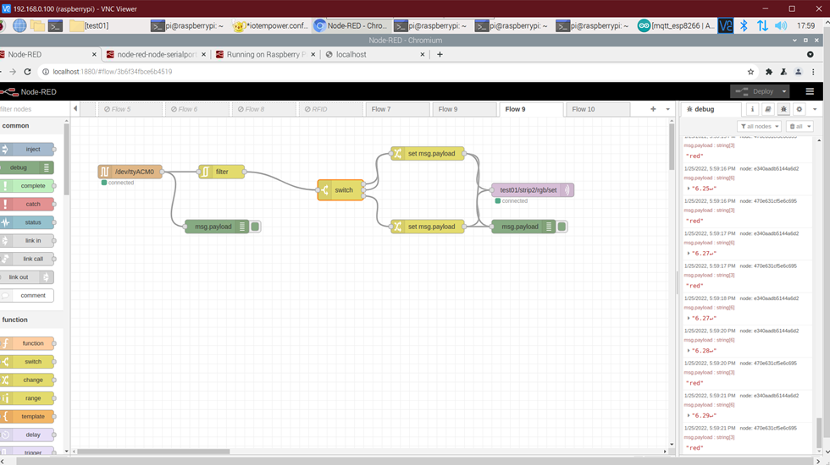
Node-Red
Flow in Node-Red
Notes:
Maltie

Slide 8
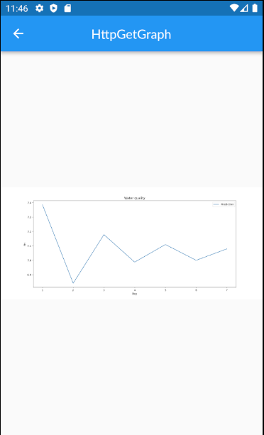
Integration with CheckMyWater
Front-end
Main API
Database
Python prediction API
Notes:
Tom

Slide 9
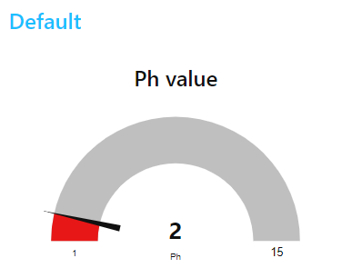
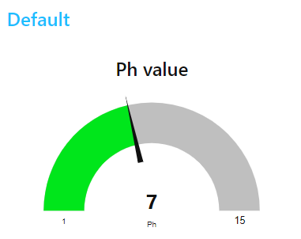
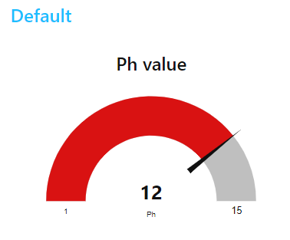
Struggles
Getting the PH meter to work.
Serial communication (Node version, right bps, printing the right stuff.)
Time/School closing
Otherwise:
Visible in mobile app or node-red gauge
Notes:
Tom

Slide 10
Reflection
MQTT
Node-red (flows)
LED strips
Arduino IDE
Notes:
Tom

Slide 11
"Water is the driving force of all nature"
- Leonardo da Vinci
Notes:
Maltie

Slide 12
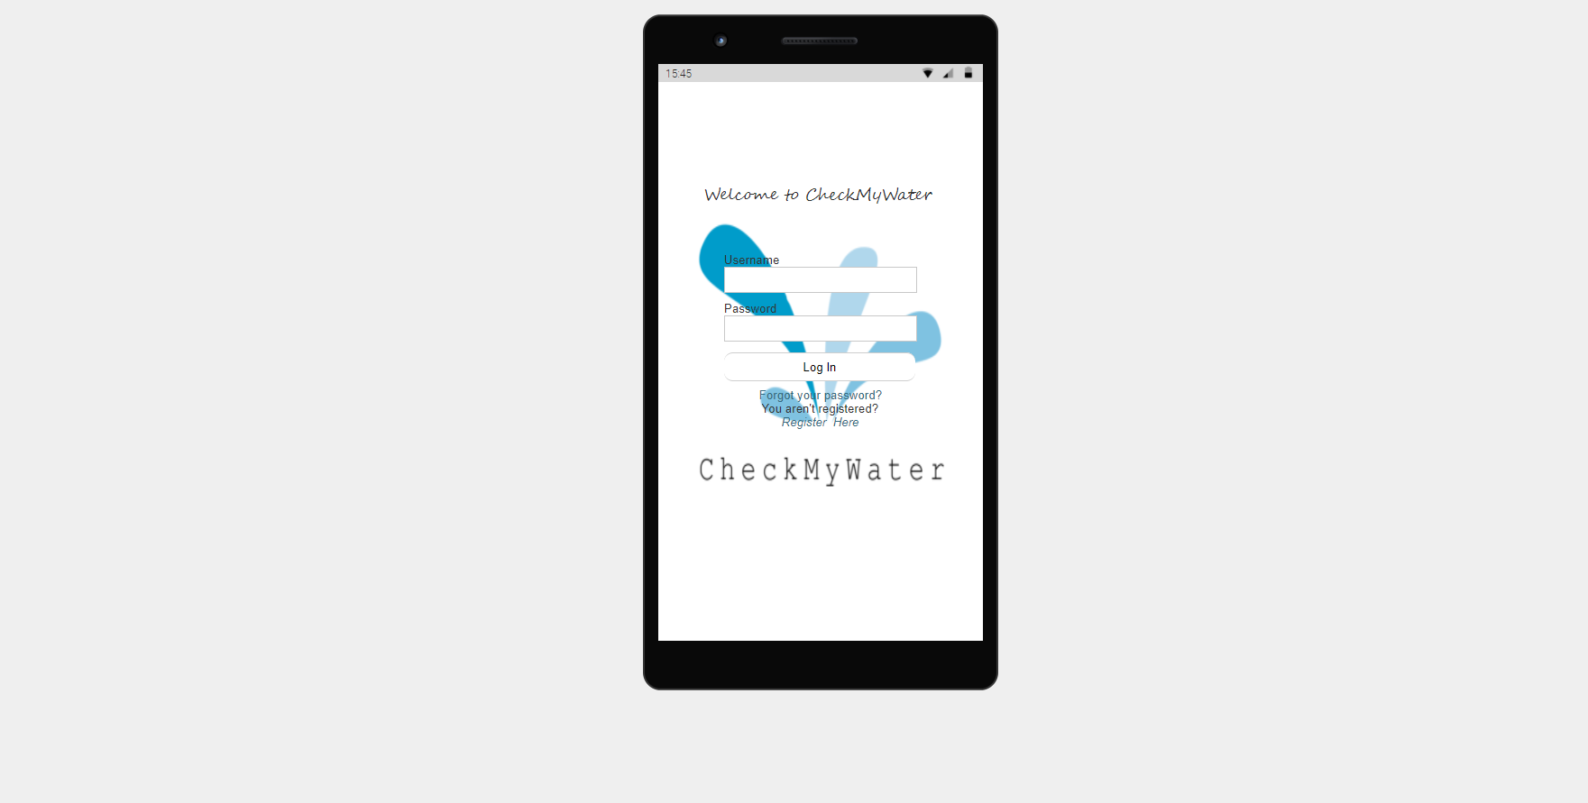
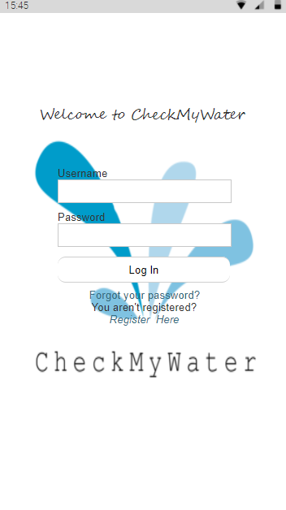
Thank you!
Notes:
Maltie

